Slide 1
Mid-Michigan Health Impact Assessment Toolkit
Resources and Tools for Conducting Health Impact Assessments in Communities
School of Planning, Design & Construction
and
Institute of Water Research at Michigan State University

Slide 2
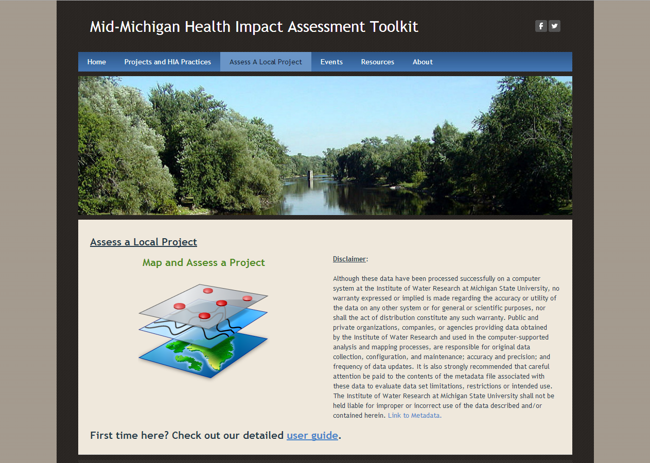
HIA Toolkit Access
http://hiatoolkit.weebly.com/index.html

Slide 3
HIA Toolkit Home Page
Guidance for conducting HIAs
Information on the HIA process
Links to national, state, and regional programs on HIA
Online forum for sharing HIA-related events, experiences and ideas
Samples of HIAs in our region
Access to the mapping and impact assessment application – Assess a Local Project

Slide 4
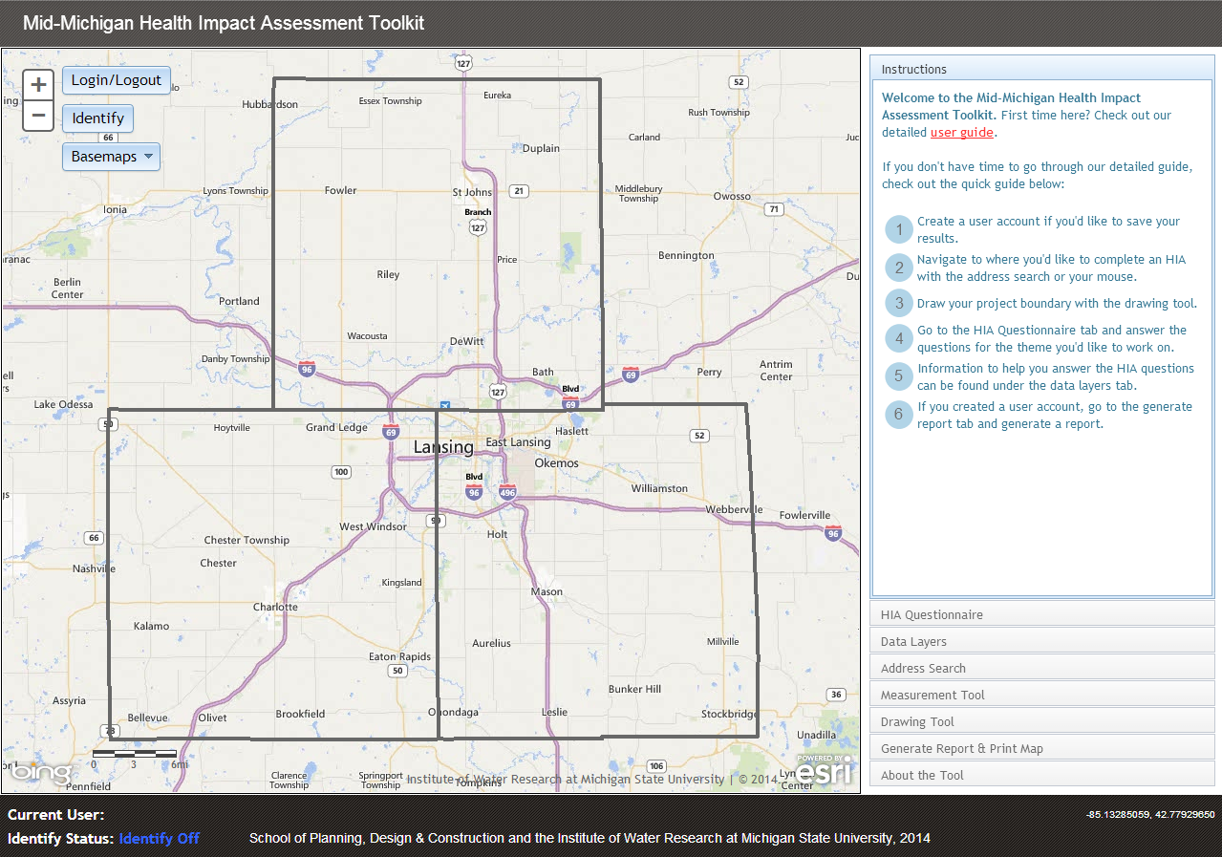
Assess a Local Project Page
http://35.8.121.111/hia/

Slide 5
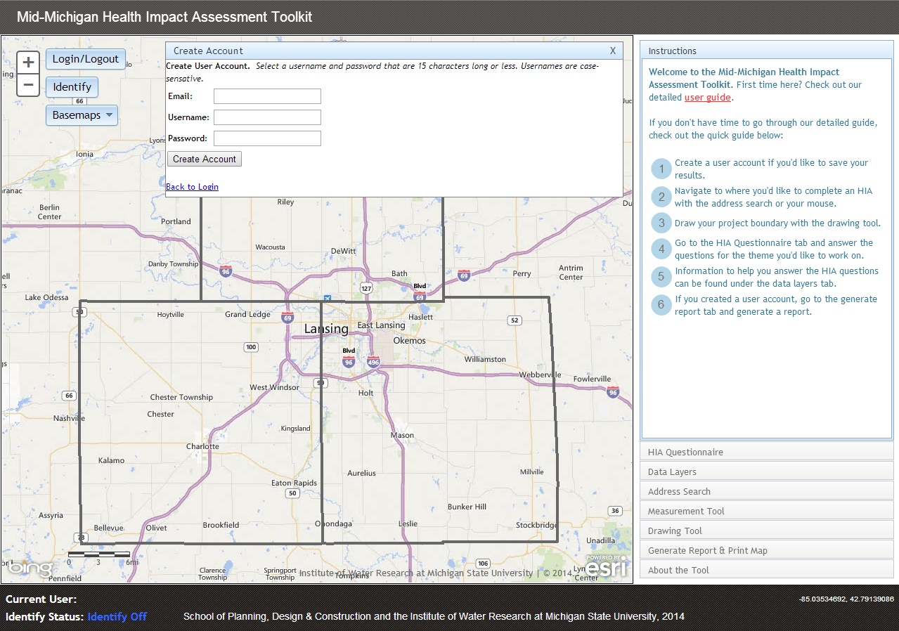
Creating an Account

Slide 6
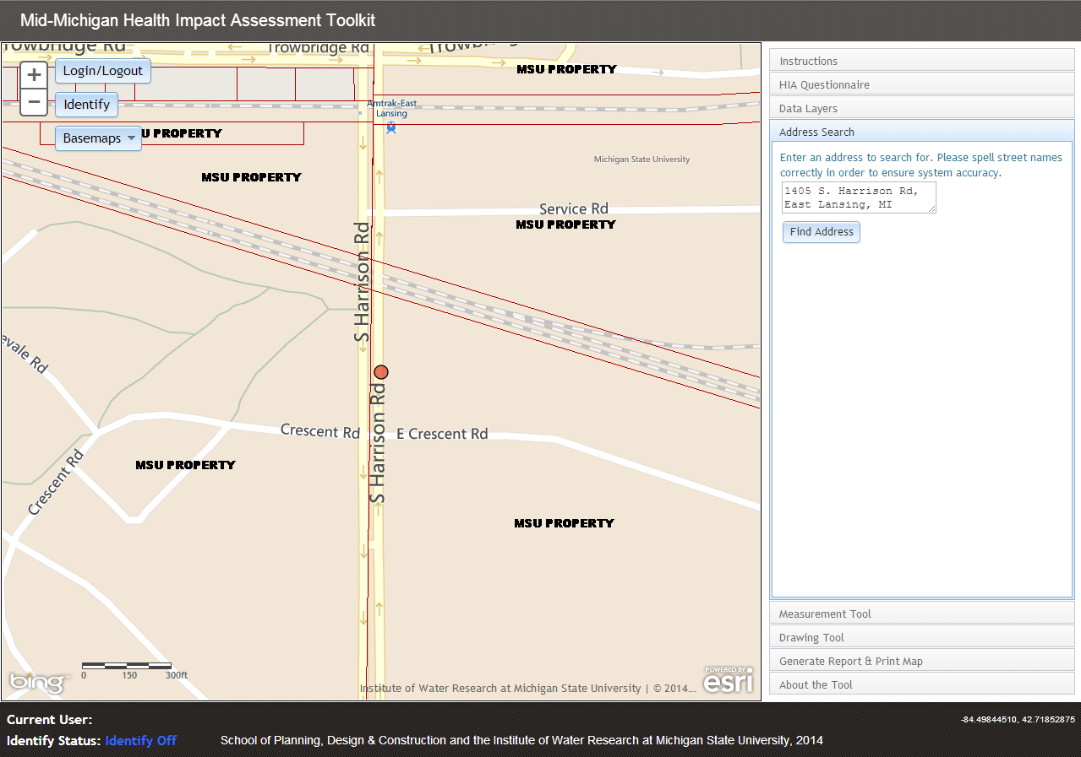
Address Search
Use the address search to find a location (or just use your mouse).

Slide 7
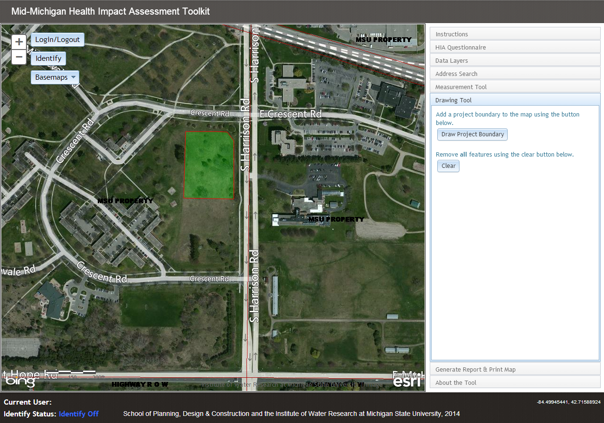
Drawing Tool
Double-click to finish drawing a project boundary.

Slide 8
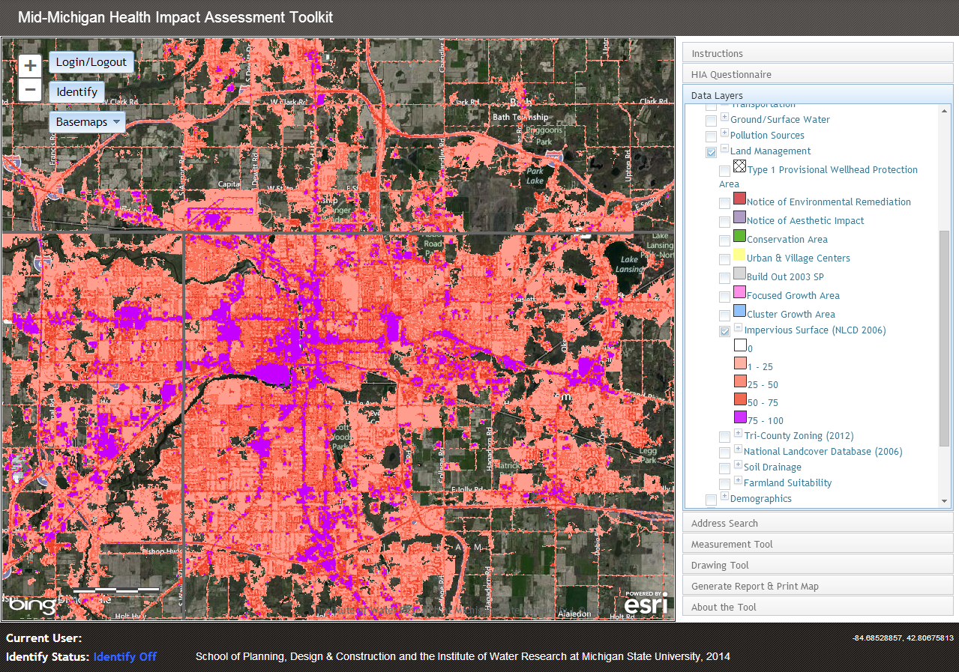
Access Data Layers
Turn layers on/off by clicking the checkbox next to them.

Slide 9
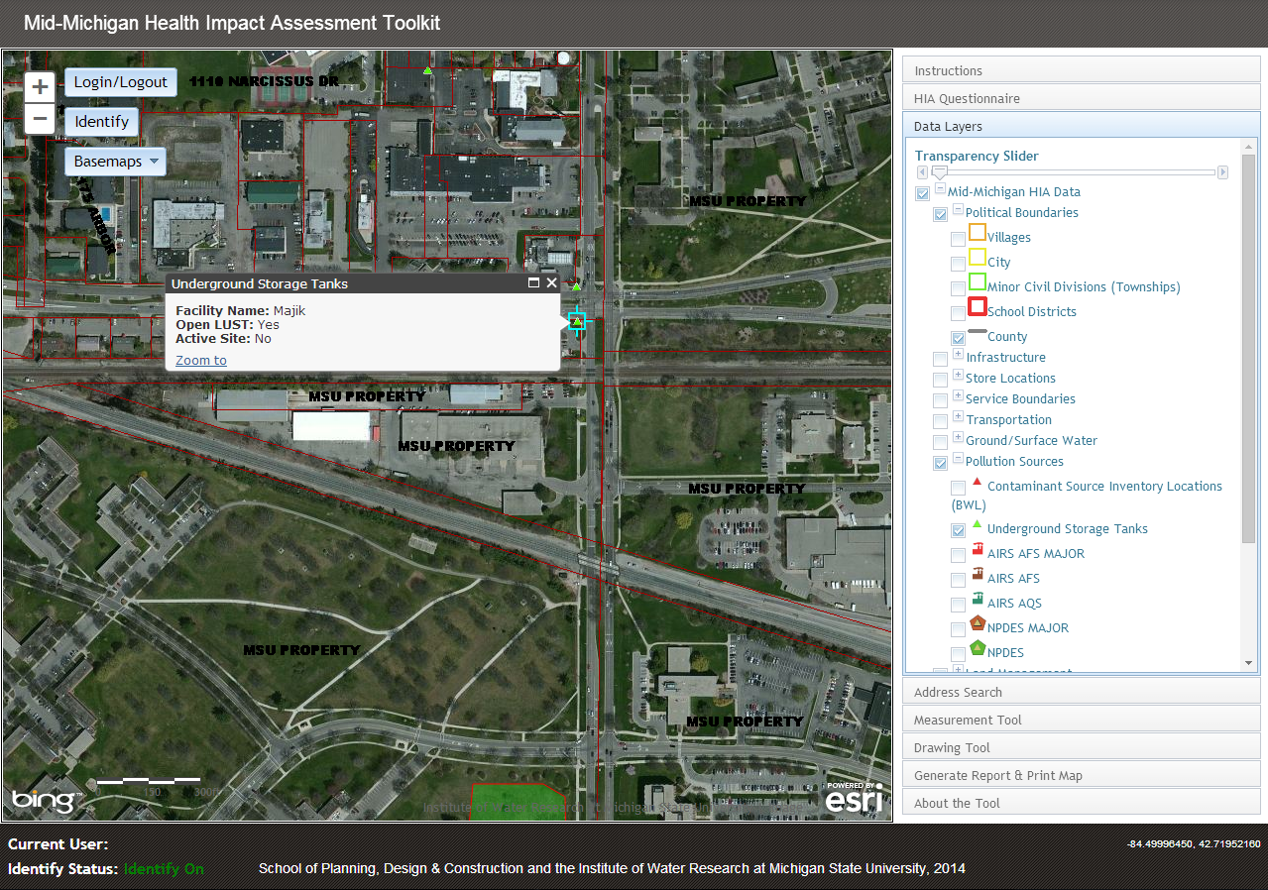
Identify Tool
Retrieve info about data layers by turning on the identify tool.

Slide 10
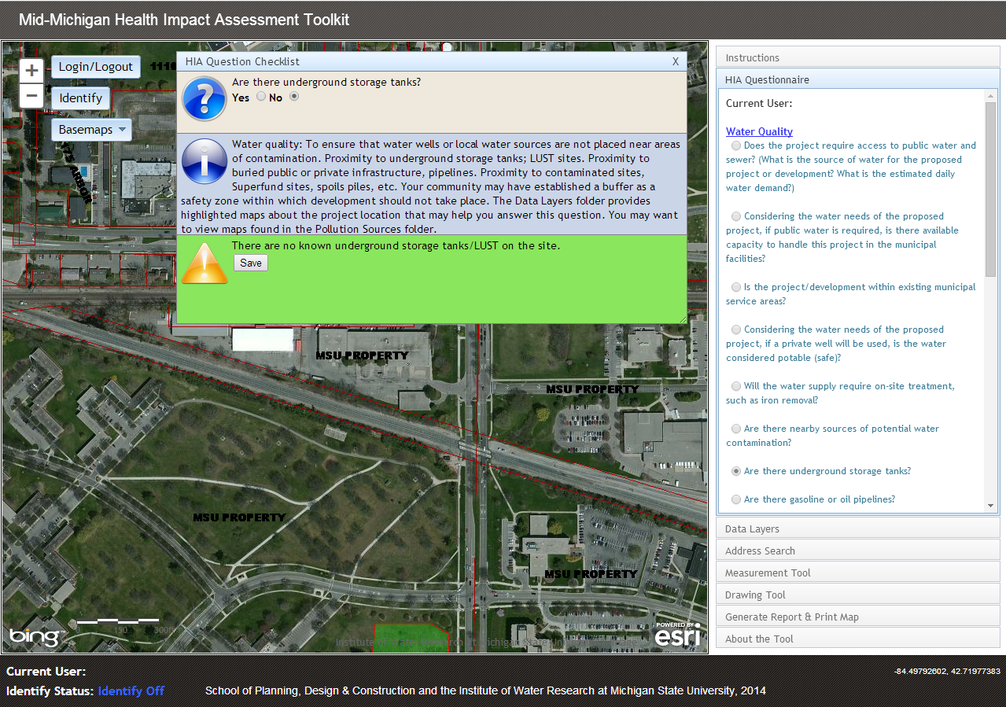
HIA Questionnaire

Slide 11
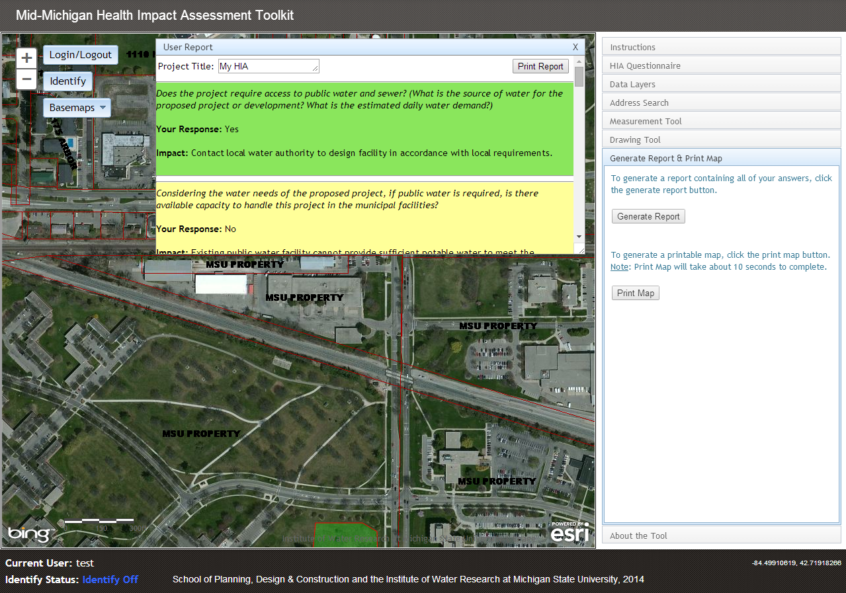
Generate Report
Click “Print Report” to either print or create a PDF document

Slide 12
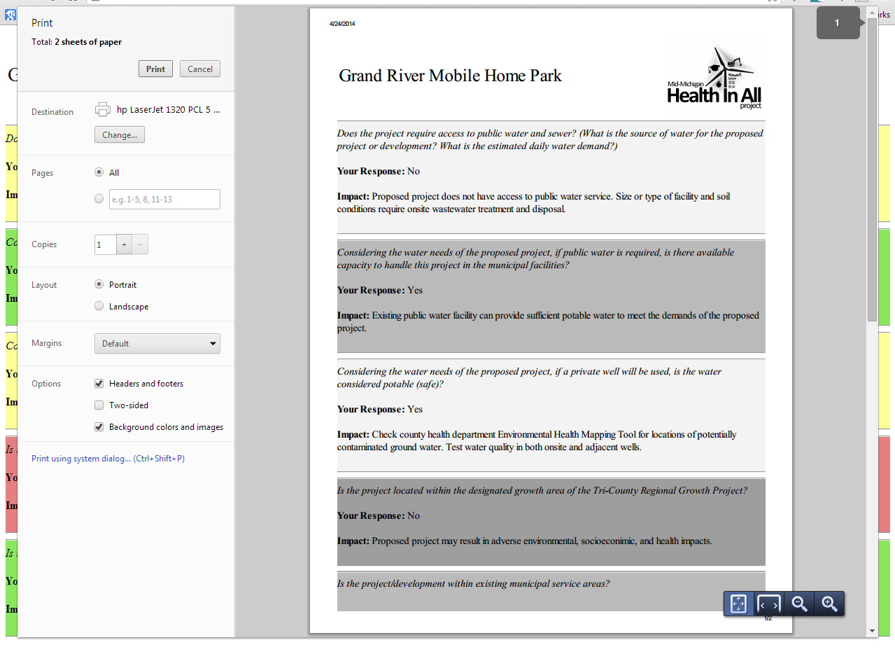
Print Report

Slide 13
Contacts
Find the HIA Toolkit
  MSU: http://hiatoolkit.weebly.com/index.html
  Tri-County Regional Planning Commission:
  http://www.mitcrpc.org
  Mid-Michigan Program for Greater Sustainability:
  http://www.midmichigansustainability.org/
For more information:
  Susan Pigg, Tri-County Regional Planning Commission, spigg@mitcrpc.org, 517-393-0342
  Mike Thomas, MSU School of Planning, Design and Construction, thomasmr7@comcast.net, 517-332-2986
  Janine Sinno Janoudi, Ingham County Health Department, jsinno@ingham.org, 517-887-4664

